Slide 1
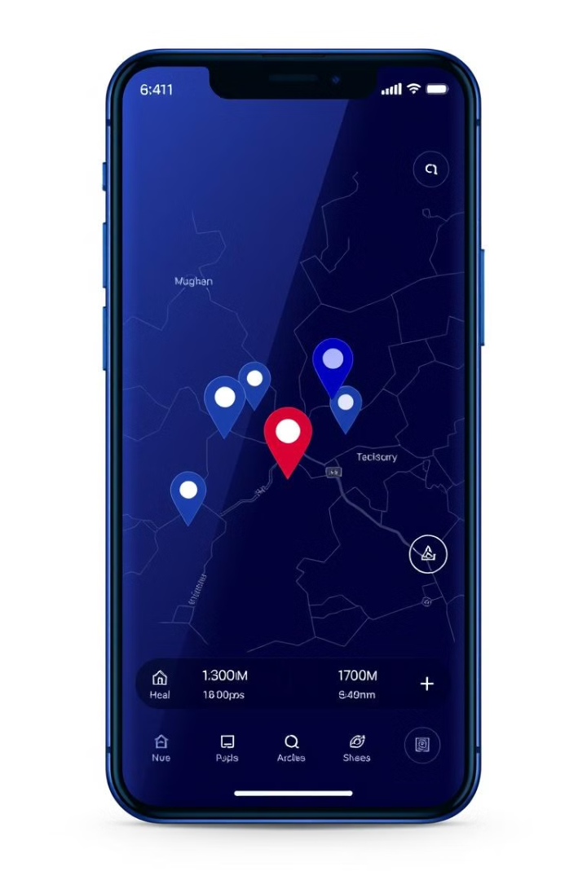
Women Safety System Using GPS and GSM
Presented by:
21J41A04C8(Thanda Bhanu)
22J45A0408(Ganti Siddarth)
21J41A04A5(Midde Nikhil)
21J41A04C2(S. Vaibhav)
Project Guide :
Dr. C .Laxmikanth Reddy
( Assistant Professor)

Slide 2
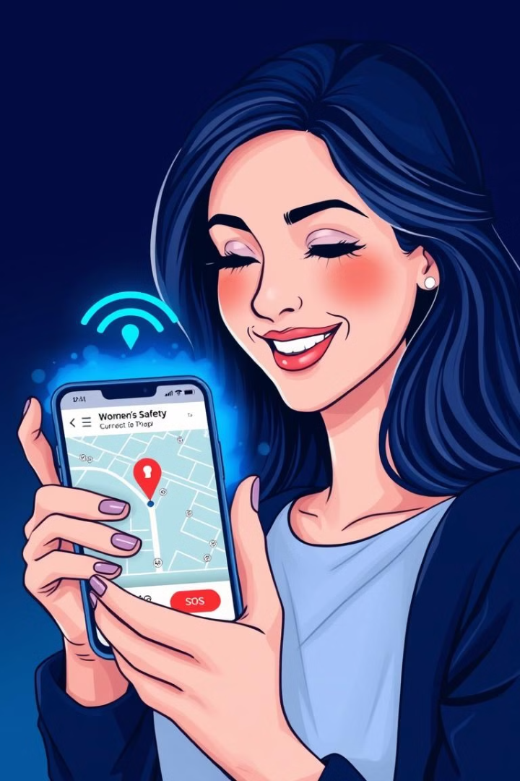
Objective
This project aims to create a responsive, real-time safety system for women using GSM and GPS technology, centered on the Arduino Uno platform. The system allows a woman in distress to press a button, triggering an immediate SMS alert with her precise location (latitude and longitude) sent to predefined emergency contacts.

Slide 3
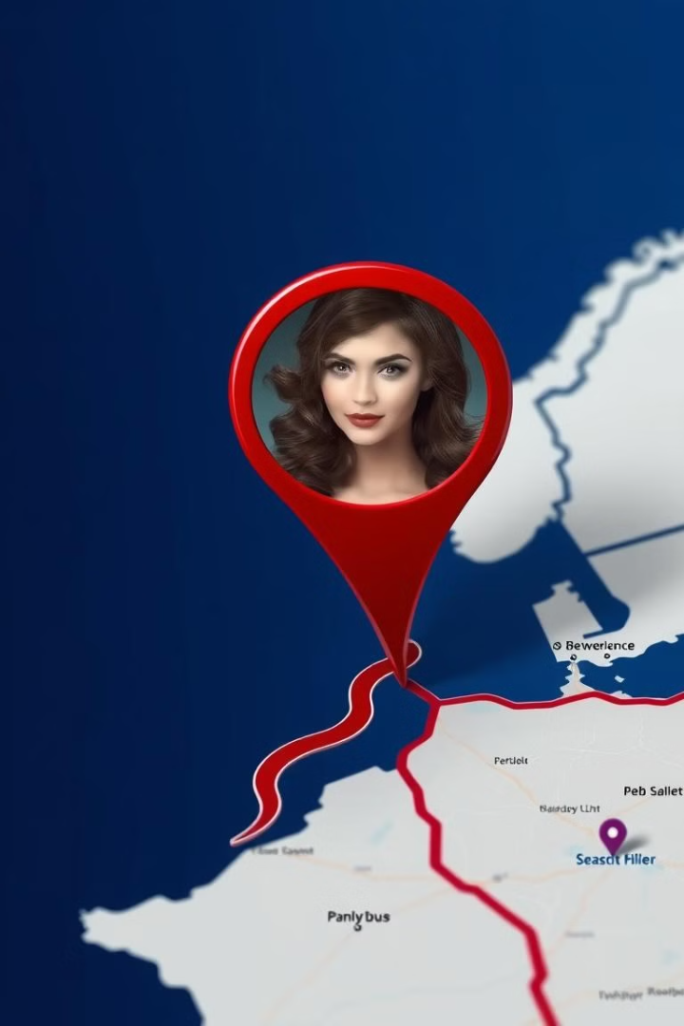
Abstract
The project introduces a women’s safety system using GSM and GPS technology.
Built on an Arduino Uno microcontroller, it enables quick emergency response.
A single button press activates the system when a woman feels threatened.
The Arduino collects location data from the GPS module and sends it via GSM.
Latitude and longitude are sent by SMS to predefined emergency contacts.
An LCD display provides real-time system status and location update.

Slide 4

Introduction: The Need for Women's Safety.
Women’s safety is an important concern today, needing quick and reliable solutions.
Many existing safety apps rely on smartphones and internet, which may not work in emergencies.
This project introduces a Women Safety System using GSM and GPS technology.
With one button press, the device sends location alerts to emergency contacts.
It provides immediate help by sharing real-time location in emergencies.
This system is simple, affordable, and designed to offer dependable safety for women.

Slide 5





Proposed Method
The proposed method utilizes a combination of GPS and GSM technology to create a comprehensive safety system. This system will address the limitations of existing solutions and provide women with a more reliable and user-friendly experience.
GPS Tracking
GSM Communication
User Interface
Safety Features
Accurately track the user's location in real-time using GPS technology.
Enable communication with designated contacts or emergency services via GSM network.
Develop a user-friendly interface for sending alerts, customizing settings, and managing contact information.
Implement features like automated alerts based on pre-defined parameters, and a panic button for immediate distress calls.

Slide 6
Drawbacks of Existing Systems.
Current safety systems often have limitations that hinder their effectiveness. Existing solutions might lack user-friendly interfaces, real-time tracking capabilities, or reliable alert mechanisms.
Drawbacks of the Disha Scheme
Limited Awareness: Many are unaware, especially in rural areas.
Technology Dependence: Relies on smartphones and internet access.
Response Delays: Police response may be slow due to resource limitations.
Resource Constraints:Limited resources affect effectivenes in remote areas .
Maintenance Issues: Technical glitches may hinder app functionality.

Slide 7
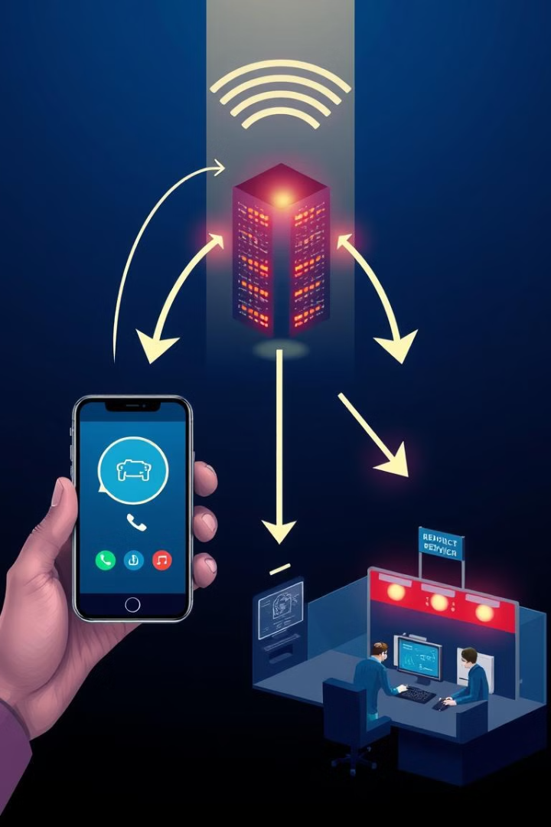
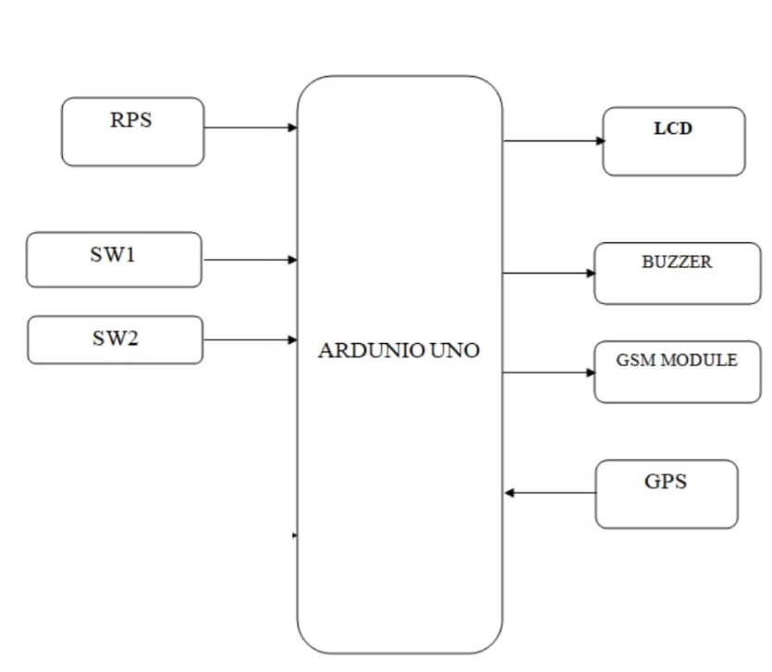
Block Diagram

Slide 8
Advantages and Limitations
ADVANTAGES:
Easily tracks a women’s location.
Affordable not so expensive.
The buzzer helps to gain people's attention.
Emergency case will get the information.
LIMITATIONS:
This is applicable for only large farms.
Have limited life after installation.

Slide 9
Conclusion
The Women Safety System using GSM and GPS is a simple and effective way to improve women’s safety. With just one press, it quickly sends location alerts to emergency contacts, helping to get support faster. Its low cost and ability to work without internet make it useful for everyone, anywhere. This system is a valuable step toward making women feel safer and more secure in all situations.

Slide 10
THANK YOU !

